Slide 1
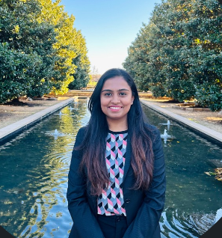

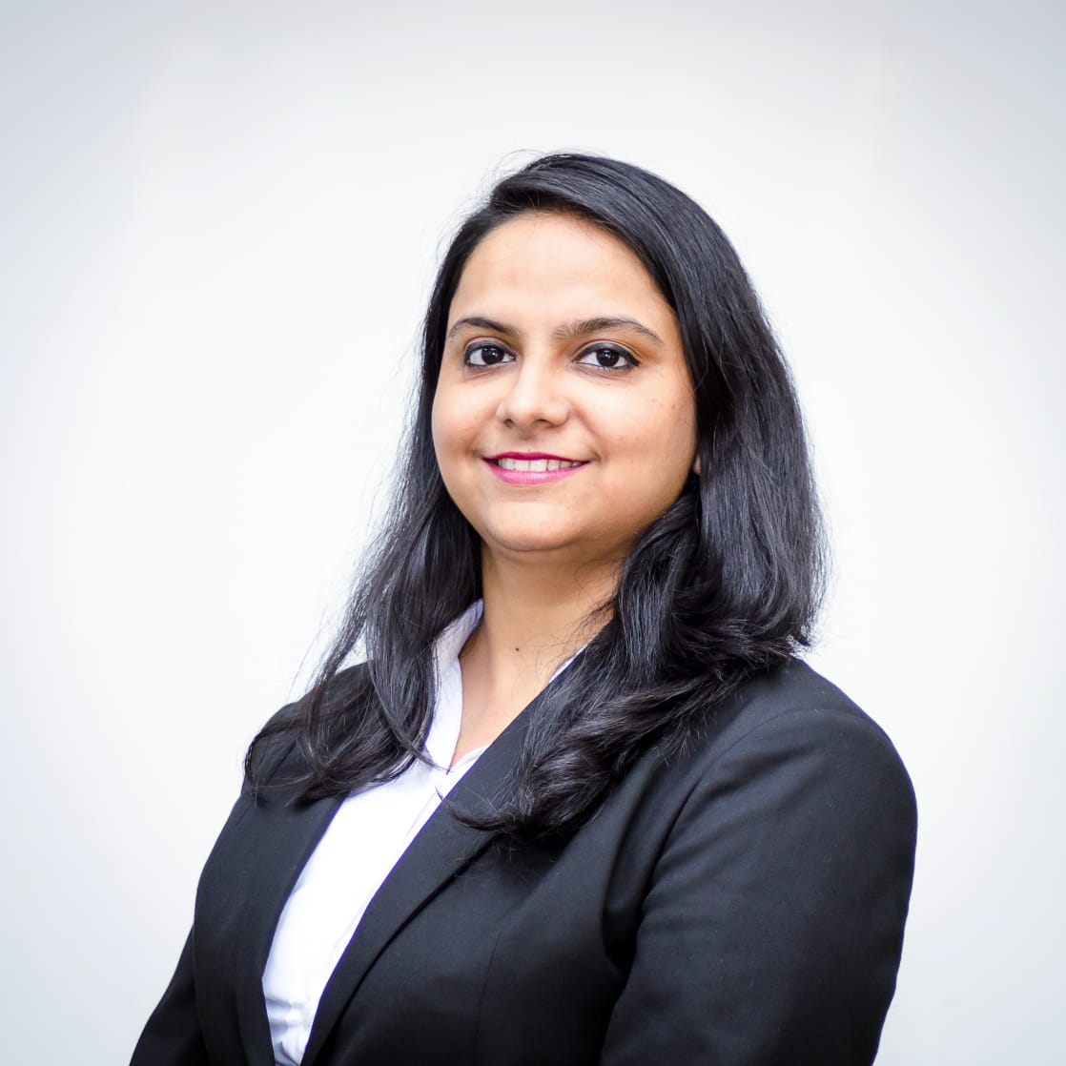


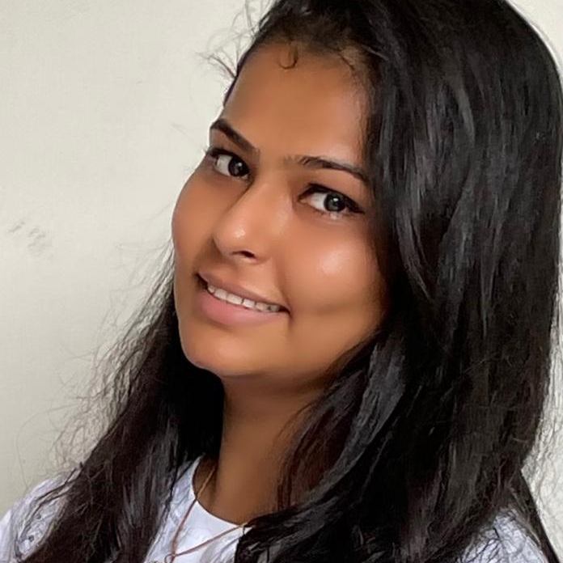
GROUP 3 - TEAM MEMBERS
Pragathi Beedu
Vikas Dod
Riddha Mathur
Jay Jain
Sushrutha S
Nitisha Meghwal

Slide 2
PROBLEM STATEMENT
Geographical barriers
Inadequate nutrition guidance
Lack of personalized training
Limited performance insights

Slide 3
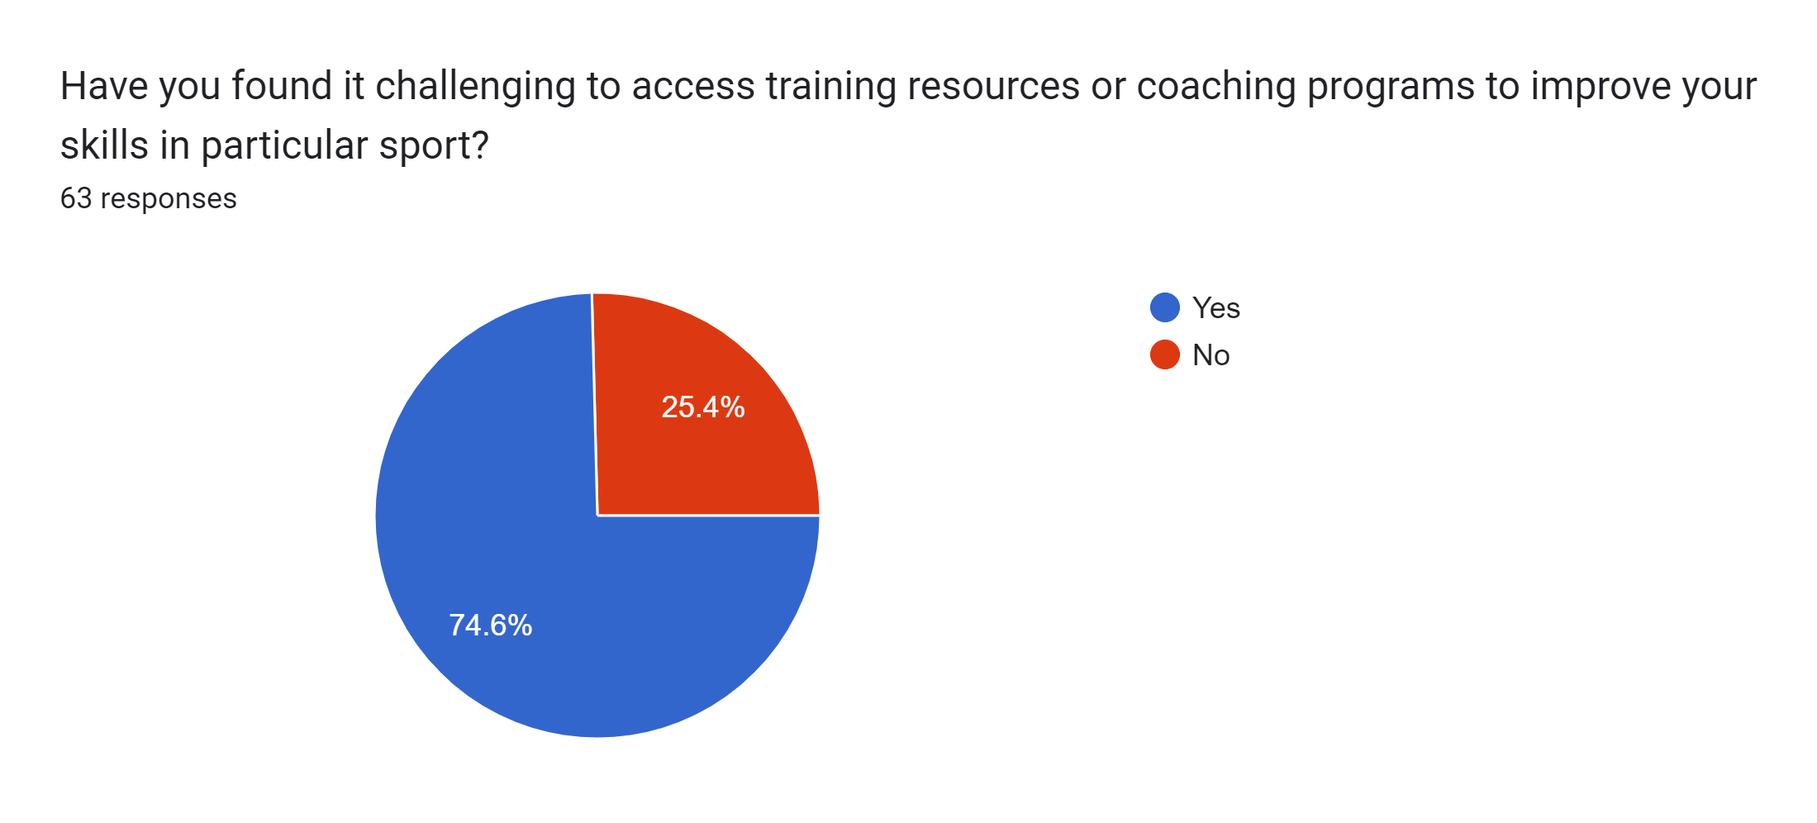
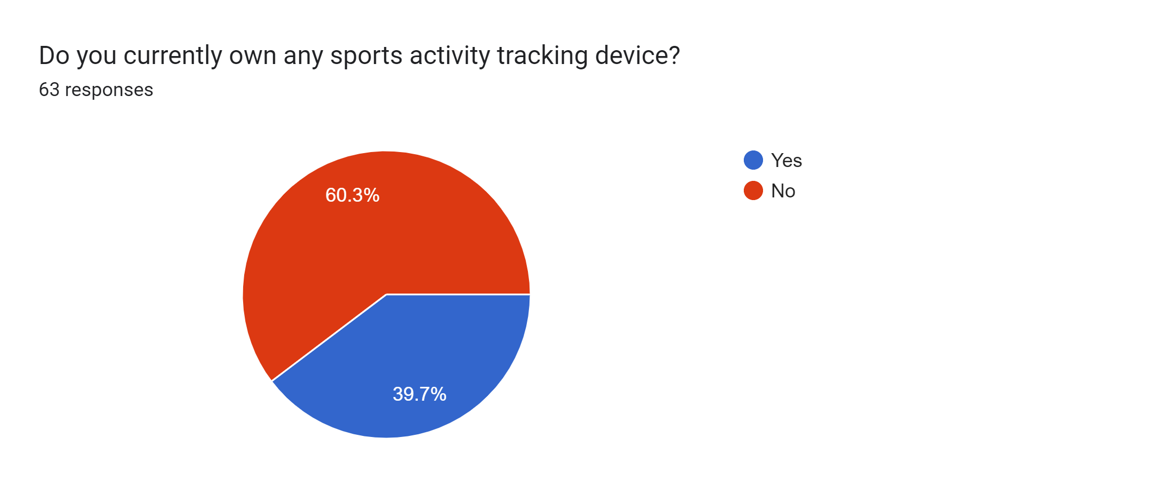
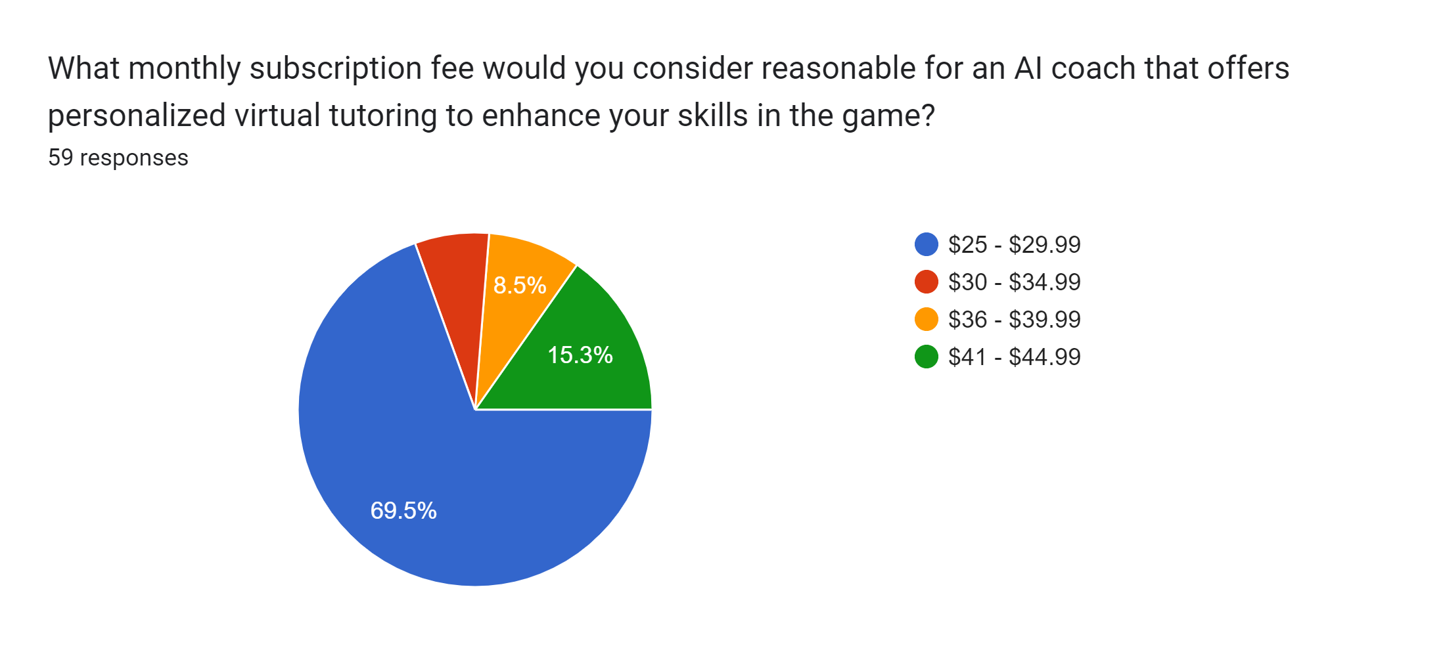
SURVEY INSIGHTS
Challenge in sports training - A significant 74.6% of individuals faced difficulties in accessing sports training to enhance their skills.
Sports Tracking Wearables: In the realm of sports tracking wearables, 60.3% of the surveyed population remains without one, while 39.7% proudly own these fitness-enhancing devices.
Attractive Pricing: With 69.5% of the surveyed population willing to pay within the range of $25 -29.99 , our pricing aligns perfectly with the market's willingness to invest in an innovative and affordable sports coaching solution.

Slide 4
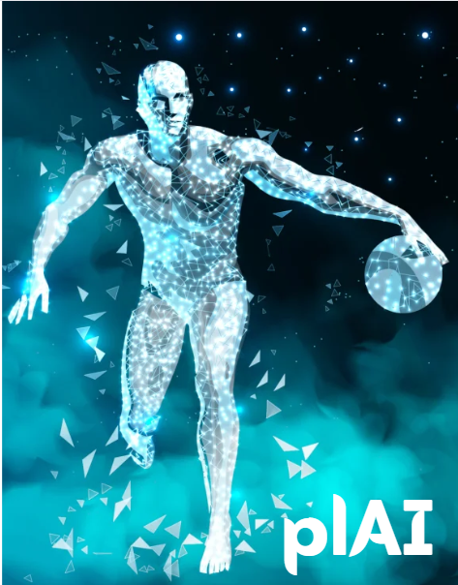
plAI
Empowering Excellence: Reach Your Peak with plAI

Slide 5
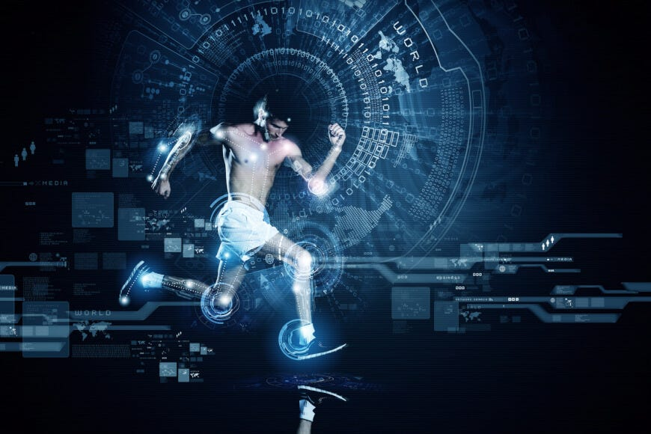
VISION
Our vision is to revolutionize the sports industry by providing a comprehensive and user-friendly Data Analytics Sports Coaching platform, enhanced with advanced AI capabilities and integrated with virtual tutoring. This innovative approach empowers sports enthusiasts worldwide, offering personalized training experiences that help them achieve peak performance, enhance their skills, and lead a healthier and more fulfilling sporting journey.
MISSION
Our mission is to make cutting-edge AI-driven coaching and tutoring accessible to sports enthusiasts of all levels, leveraging data analytics and virtual learning to maximize their potential and success in sports.

Slide 6
PRODUCT ROADMAP
2023
2024
2025
2026
User interaction with App using voice commands with the help of Natural language processing (NLP)
Creating smart sports environment equipped clubs and sports facilities with the help of AR.
Athlete recruitment and management
Advanced AI Analytics / In-depth analysis such as injury risk forecast
Expanded Sport Coverage
Live scores, podcast and blogs
Sports scholarship Initiative
Yoga fitness and recovery sessions
Basic AI Analytics using IOT wearables
Virtual tutoring integration
Onboarding professional coaches
Skills specific modules for targeted areas
Diet and nutrition based on player profile
Gamification – Leadership board and challenges
Social media integration
Team/Players Finder
Sport-Tunes
Launching our own smart wearables IoT Device with options to buy or rent
Global expansion and multi-Lingual support
User feedback and suggestions for the app improvement
Introducing sports equipment Marketplace
Corporate wellness program

Slide 7

PRODUCT STRATEGY

Slide 8
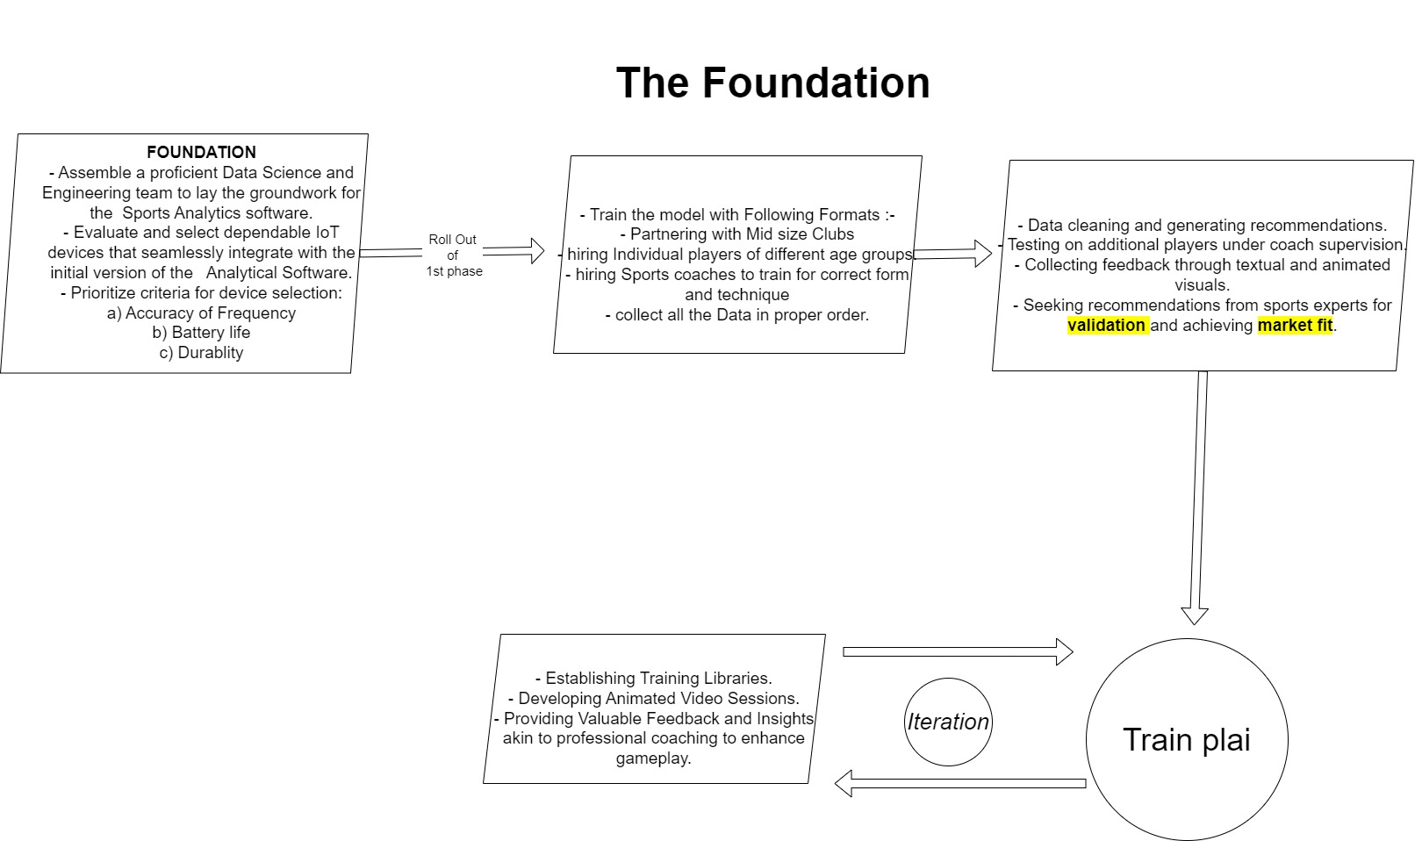
WHO we are
and
WHAT we do

Slide 9
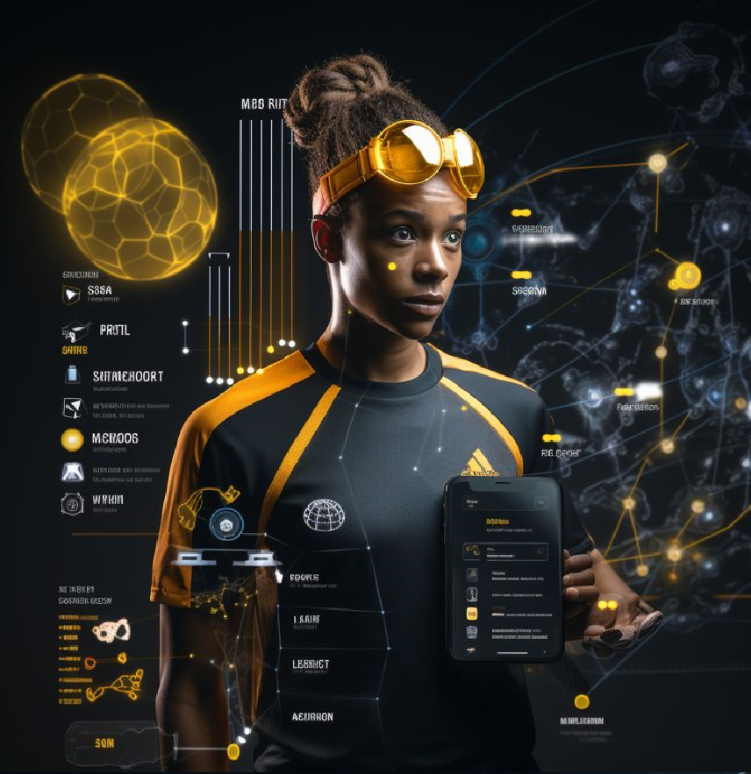
INNOVATION
IoT-Based Sensory Data Analysis
Expert Guidance Within the Platform
Data-Driven Decision-Making for Coaches and Dieticians
Revolutionizing Training Efficiency
Peer-to-peer platform
Affordable sports coaching

Slide 10
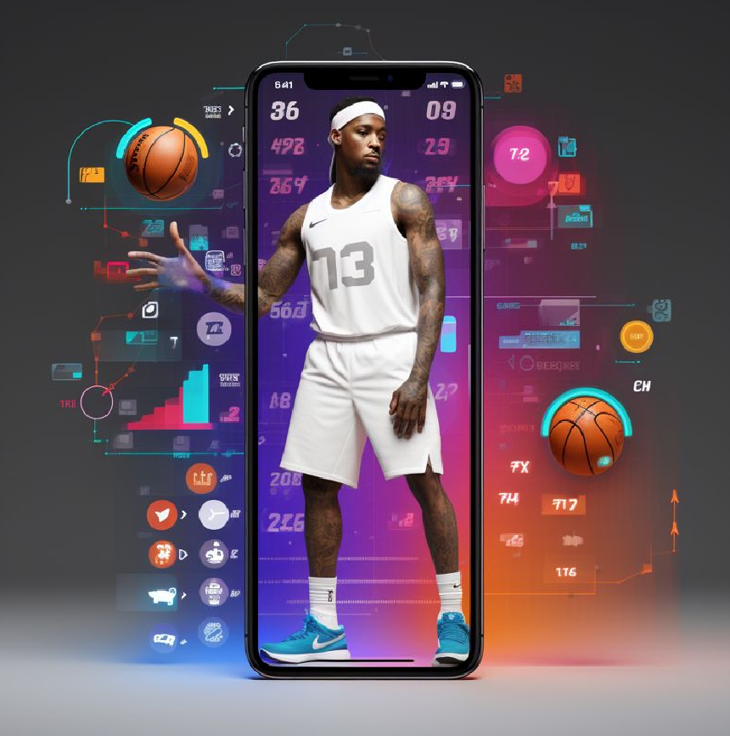
DISRUPTIVE INNOVATION
Real-time continuous feedback mechanism using trained virtual AI coach
High Accessibility – Bridging geographical barriers
Injury risk forecasting

Slide 11

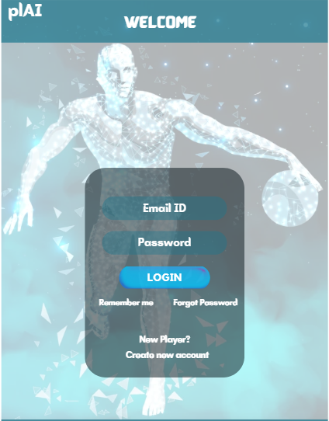
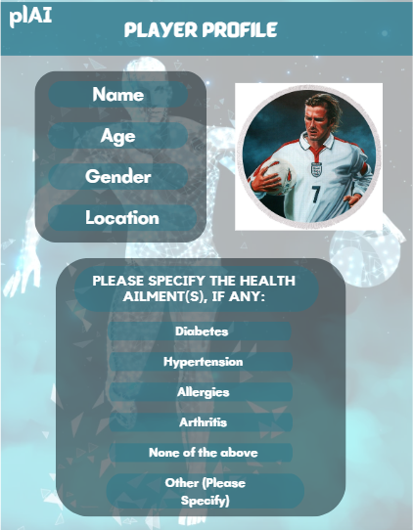
USER INTERFACE

Slide 12
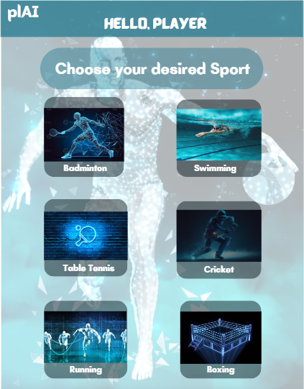
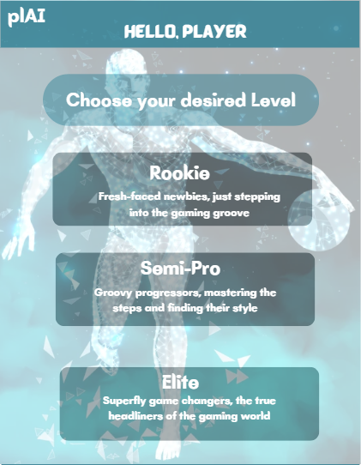
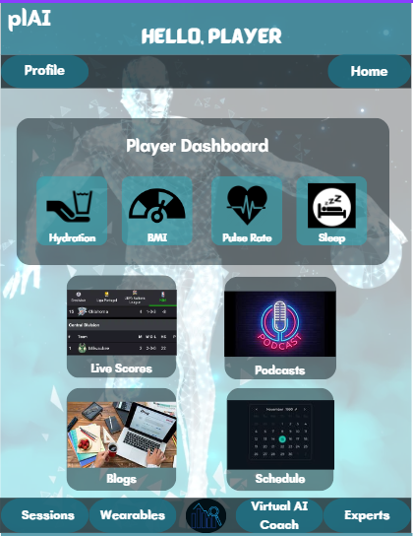
USER INTERFACE

Slide 13
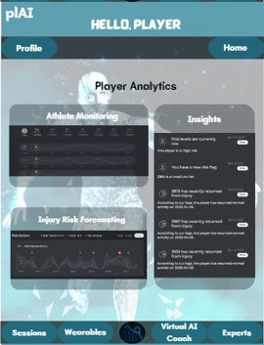
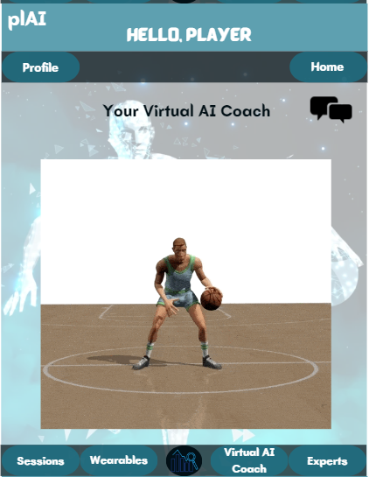
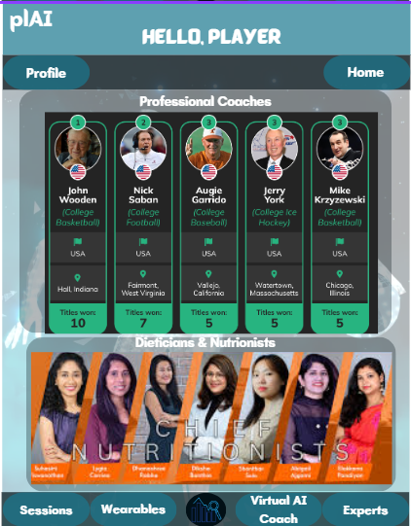
USER INTERFACE

Slide 14
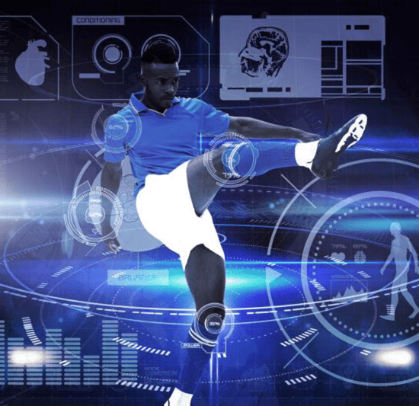
STICKINESS
Building a Thriving Community
Habit-Forming Challenges
Team/Player Finding
Success Stories Showcase
Reward Points
Sports Scholarship

Slide 15
VALUE CREATION
Player
Coaching Revolutionized
Expanding reach
Employee
Architects of Innovation
ESOPs
Investors
Society and Nation
A Sustainable Future
Domain Experts (Coach and Dietitian)
Enriched & empowered society
Elevating Impact
Leadership potential
Economic Resurgence
Personalized Coaching
Precision Skill Development
Safeguard Success
Thriving Market Potential
Investing in victory
Pioneering Sports Disruption

Slide 16

MARKET STRATEGY

Slide 17
Market Strategy
Target Customer
Sports Enthusiast
Pricing Strategy
Offering Competitive Pricing Plans.
Omni-Channel Marketing
Utilizing digital marketing, social media, influencer marketing, content marketing, and traditional advertising to reach and engage the target audience effectively.
Strategic Partnerships
Establishing Strategic Partnerships with IoT Device Manufacturers Collaborating with Sports Clubs to Access Valuable Data and Engage Players and Coaches for AI Training
Coaches
Dietitian
Parents of young kids
Flexible Options to Directly Purchase or Rent the IoT Devices from Third-Party Suppliers

Slide 18
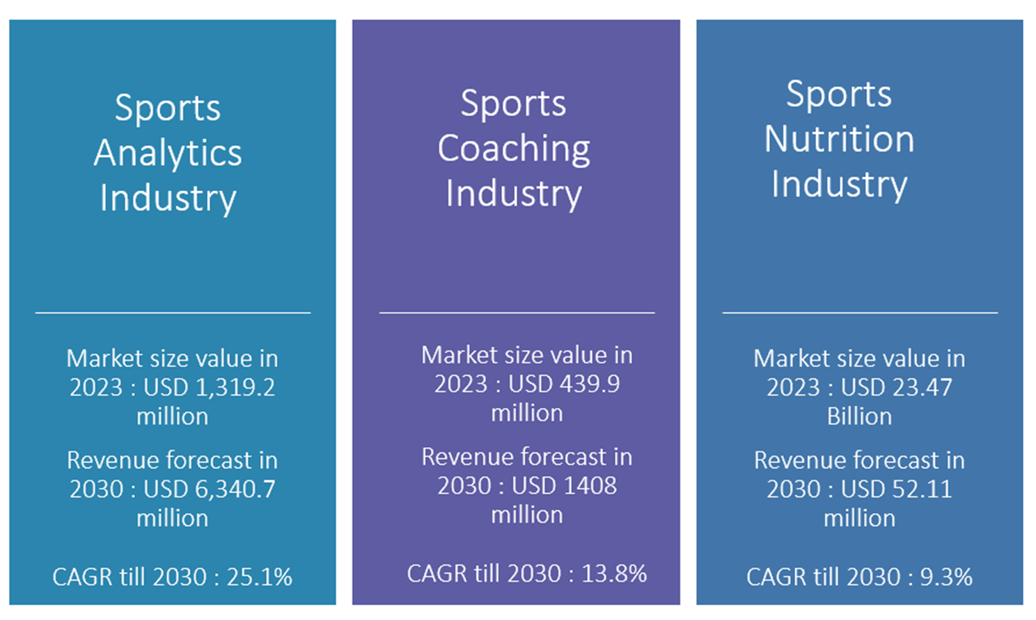
Market Size

Slide 19
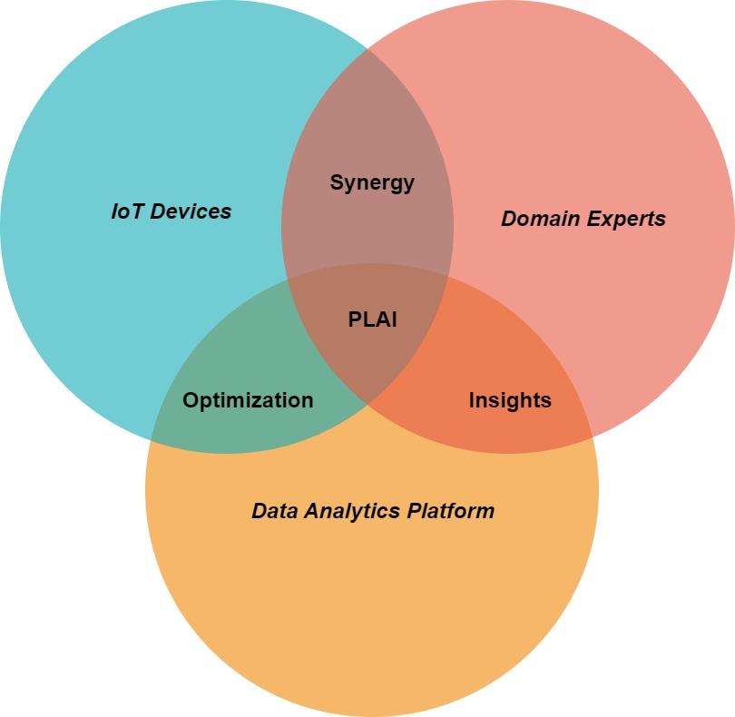
3 Pillars of PLAI

Slide 20
Competition
Sports Analytics Companies
Sports Performance Monitoring Systems
Sports coaching platforms
Sports Nutrition and Diet Services
Sports Coaching Institutions

Slide 21
Market Types
Existing/New Market
Combined Sports Data Analytics with AI based Sports Coaching
Competitors in adjacent industries but not precisely in AI based Sports Coaching
Creating a New Affordable Market for Sports Enthusiasts
Exponential Market
First-mover Advantage
Sports Analytics Industry CAGR of 25.1%
Customer-base created
Introducing in-house wearable IoT devices
​
​
​
​

Slide 22
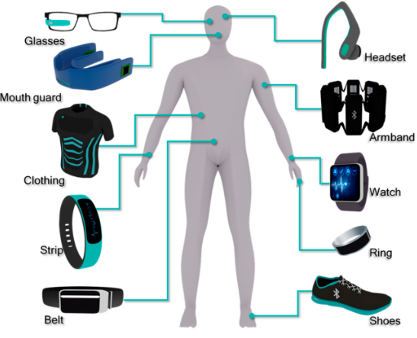



Adjacent Market
Smart Wearable IoT Devices
Athlete Recruitment and Management Company
Sports Equipment Marketplace
Sports Motivation Music
Introducing a line of Smart Wearable IoT Devices
Bridge the gap between talented athletes and potential clubs, teams, and sponsors
Comprehensive Market Platform for Sports Equipment
Specific Sports Music playlists to enhance player motivation

Slide 23
Marketing Strategy
SPECIFIC STRATEGIES
Targeting Parents - Give your young athlete the advantage of IoT-based data analytics, personalized coaching, and expert insights to enhance their game. Invest in their sports future now!"
Targeting Coaches – A valuable tool that complements their expertise and helps them deliver more effective training sessions. Coaches will be intrigued by the opportunity to leverage advanced data analytics and AI-driven insights to enhance player performance and gain a competitive edge in their coaching approach.
Social media influencers in the sports industry can amplify the product's reach and credibility.
Hands-On Demonstrations, Interactive Workshops, and Expert Insights.
Targeting Players - Maximize Your Performance with IoT-based Data Analytics and Expert Coaching, Tailored to Your Needs. Empower Your Journey, Regardless of Resources.
Other Referral and Affiliated programs.
Targeting Small Sports Club - Create a High-Performance Environment for Players to Thrive and Achieve Their Goals. Partner with us to revolutionize sports training at your club.

Slide 24

Business Model & Pricing Estimates

Slide 25
Business Model and Pricing Estimation
Subscription
Commission
Advertising
Direct Sales & Renting
1 month free for new users
Three interval options (monthly/quarterly/annual)
Monthly - $30 and gradually increasing the fee up to $40 by mid FY 2025
Quarterly - $65, Annual - $150
5% from Coaches
5% from Dietitians
In-app/click based advertising - $1/1000 clicks
Sponsored Ads - $5 per transaction through app
Sales price at a minimum markup of 50% over manufacturing cost
Renting IoT devices anywhere between 5% - 10% of sales price
5% from Vendors

Slide 26

Cost & Revenue Estimation

Slide 27
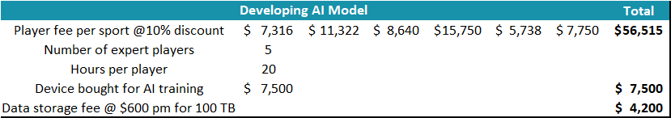
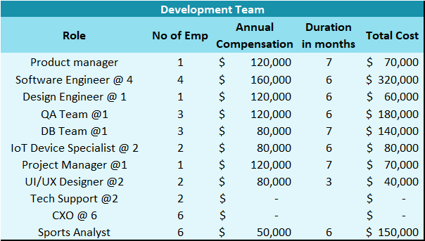
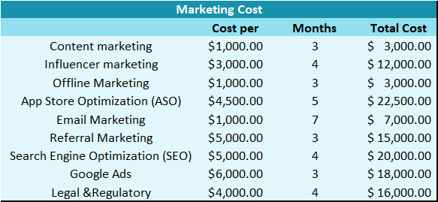
Cost Estimation – Development phase
*Cost Estimation for development phase are adjusted based on the amount of time a service is required.

Slide 28
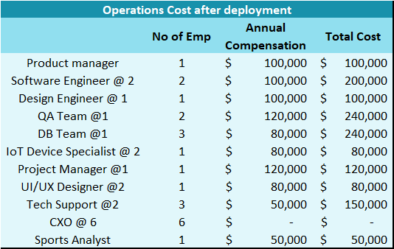
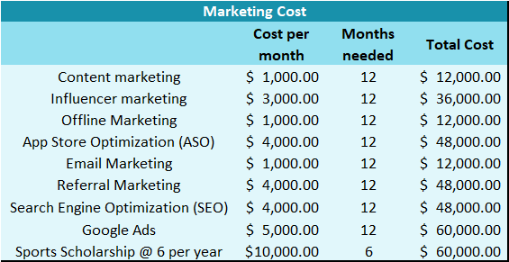
Cost Estimation – After deployment
Cost Estimation after deployment includes manufacturing cost of IoT, beginning in FY 2025 and all cost are inflation adjusted @3%

Slide 29
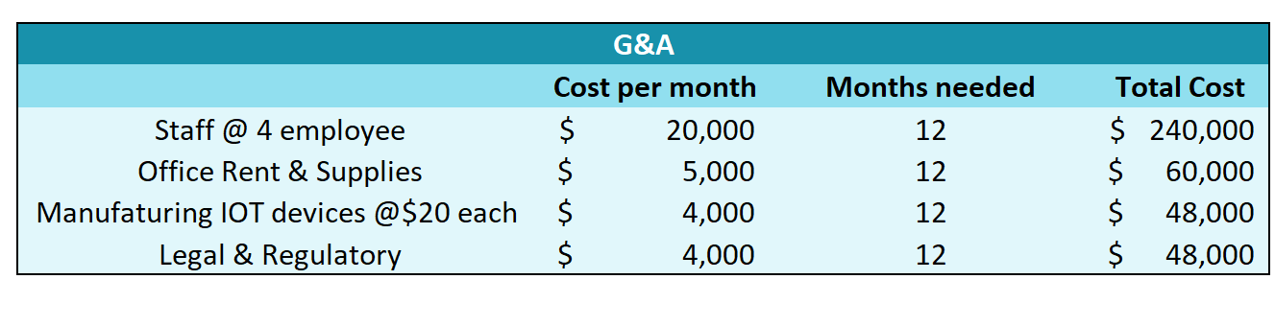
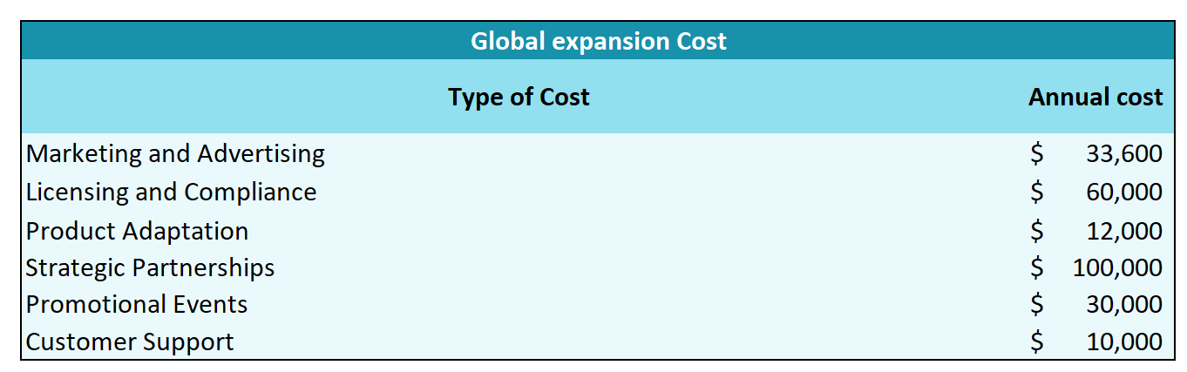
Cost Estimation – After deployment

Slide 30
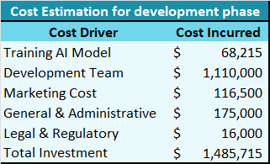
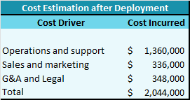
Cost Estimation - Summary
*Average prices based on current market **Fee charged per hour
*Cost Estimation for development phase are adjusted based on the amount of time a service is required.
Cost Estimation after deployment includes manufacturing cost of IoT, beginning in FY 2025 and all cost are inflation adjusted @3%

Slide 31

Sales & ROI

Slide 32
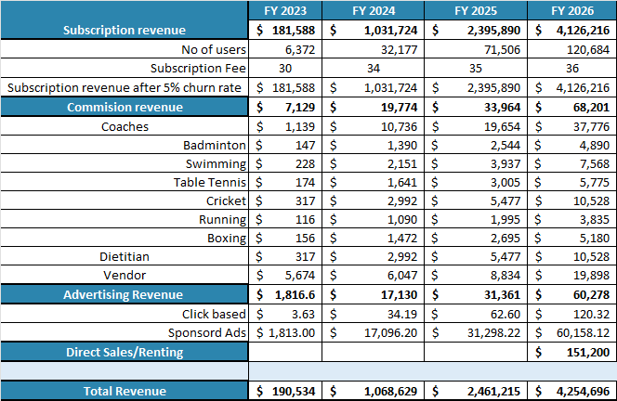
Revenue Breakdown
Subscription revenue after assuming a 5% Churn rate.
Commission is charged at 5% of the personal coaching fee/diet consultation session
1% of app users are expected to choose personal coaching/diet consultation

Slide 33
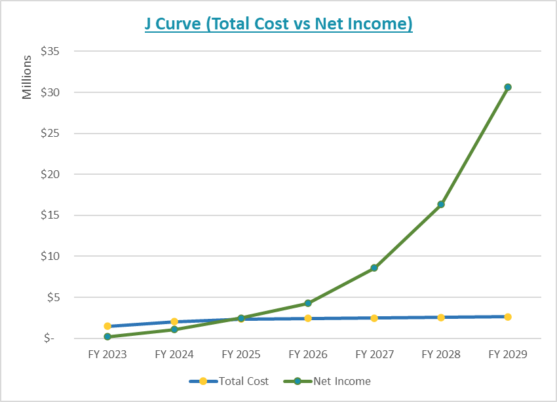
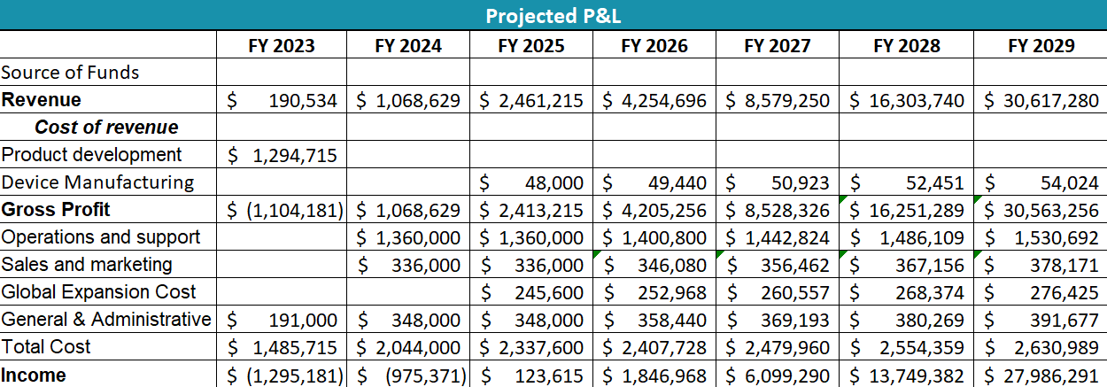
Income Projection

Slide 34
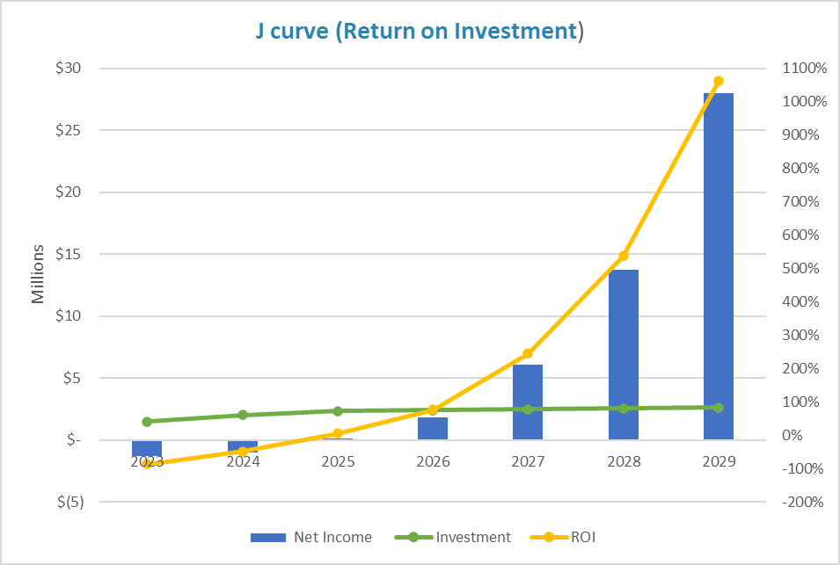
Return on Investment
An ROI of –87% in 2023
Only 3 months of revenue is estimated in 2023
Business is becoming profitable in 2nd year of App launch i.e 2025
Exponential growth is expected from 2027

Slide 35
Aftermarket Strategy & ROI

Slide 36
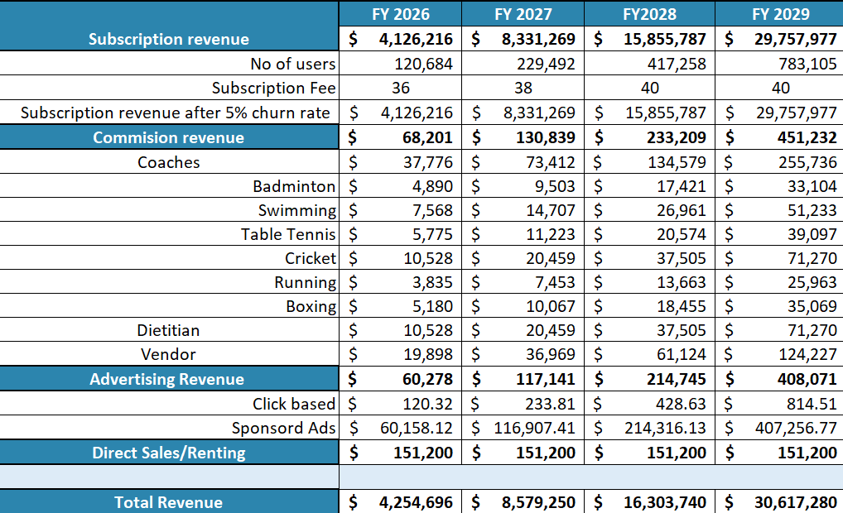
Revenue Breakdown (Aftermarket)

Slide 37
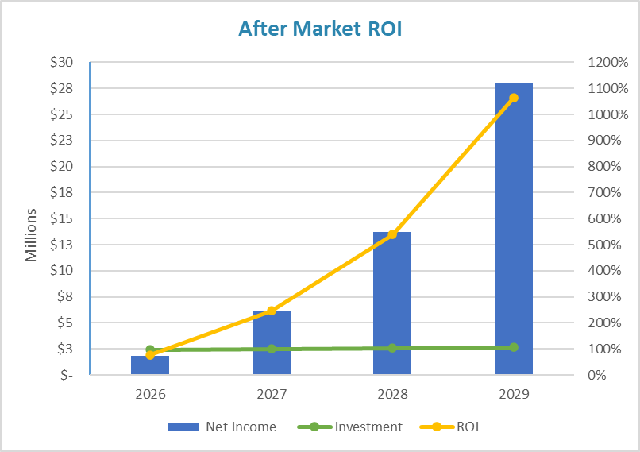
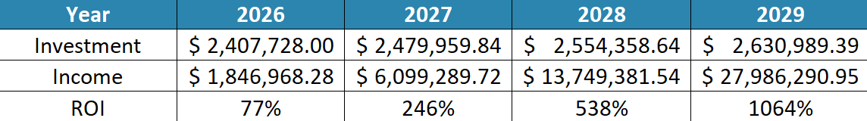
Aftermarket Strategy and ROI
We expect to attract more users through our marketing strategies and Global Expansion.
Introduction of our Sports scholarship program
Implementing Athlete recruitment and management program
Manufacturing our own IoT devices
Implementing NLP in the app to enable voice commands

Slide 38

REFERENCES
https://www.linkedin.com/advice/1/what-pros-cons-using-ai-based-career-coaching
https://www.v7labs.com/blog/ai-in-sports
https://www.analyticsvidhya.com/blog/2023/05/how-is-ai-powering-the-future-of-sports/
https://royalbadmintonacademy.com/coaching-fees/
https://jmswim.com/adult-swimming-lessons/
http://dallasaquatics.org/158/Adult-Programs
https://www.coachup.com/sports/dallas-tx/swimming
http://www.txcricket.com/one-to-one.html
https://www.coachup.com/sports/dallas-tx/running
https://www.grandviewresearch.com/industry-analysis/sports-analytics-market#:~:text=How%20big%20is%20the%20sports,USD%201%2C319.2%20million%20in%202023.
https://www.astuteanalytica.com/industry-report/sports-coaching-platforms-market
https://www.precedenceresearch.com/sports-nutrition-market

Slide 39


plAI

